Slide 1


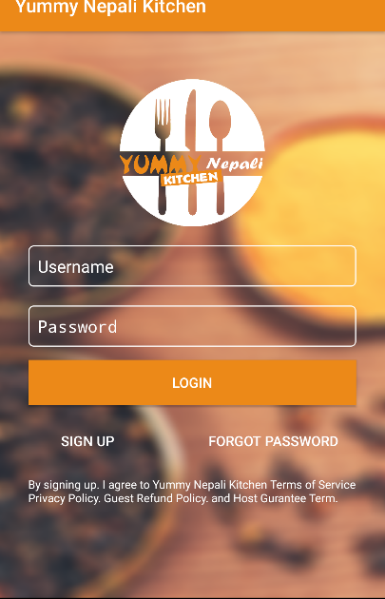
Yummy Nepali Kitchen App Project
Final Project By: Deepak Gyawali
Student ID: 10000132586
CMP 664: Mobile Applications Design and Development
Dr. Jose Garcia Rubia
Virginia International University
Fall 2017
Copyright © 2017 All right reserved, Website : www.deepakgyawali.com.np

Slide 2

Introduction
Offering online ordering lets customer to place an order more conveniently.
Greatly simplifies the ordering process for both the customer and the restaurant.
App presents an interactive and up-to-date menu with all available options in an easy to use manner.
Copyright © 2017 All right reserved, Website : www.deepakgyawali.com.np

Slide 3
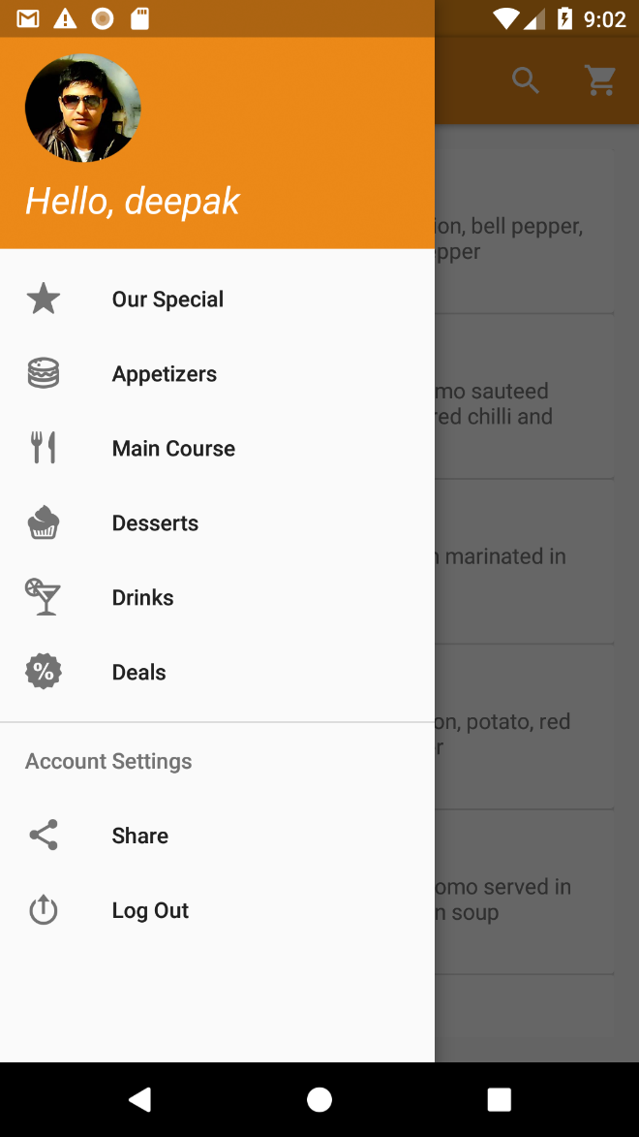
Features
Login screen with signup and forgot password features.
Navigation drawer with user greeting.
Nice images with description and price.
Add to cart, remove from cart, increase/decrease quantity features.
Copyright © 2017 All right reserved, Website : www.deepakgyawali.com.np

Slide 4
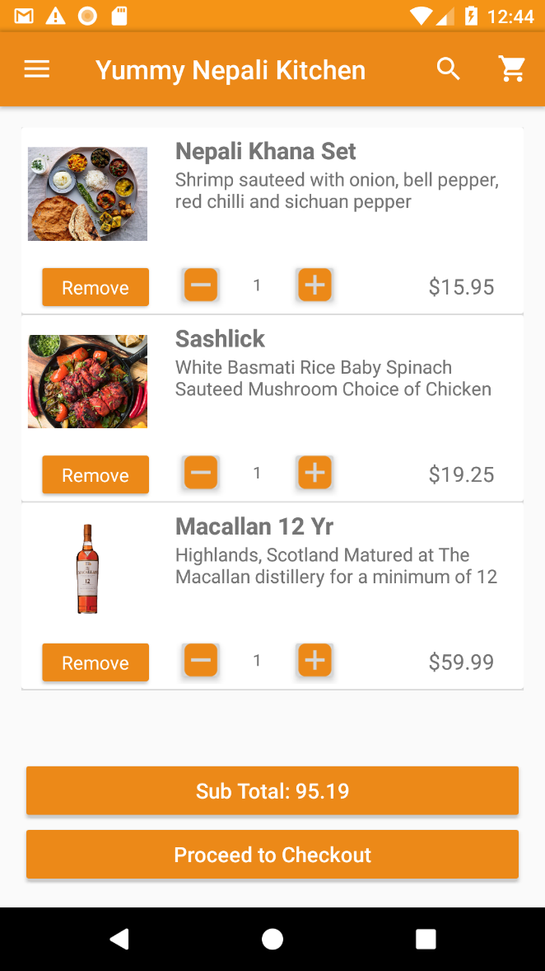
Features(contd.)
Total price of products calculated.
Proceed to Check Out Option.
Payment Options like PayPal, Cash, Credit/Debit Cards.
Data is stored and retrieved from MySQL database.
Copyright © 2017 All right reserved, Website : www.deepakgyawali.com.np

Slide 5
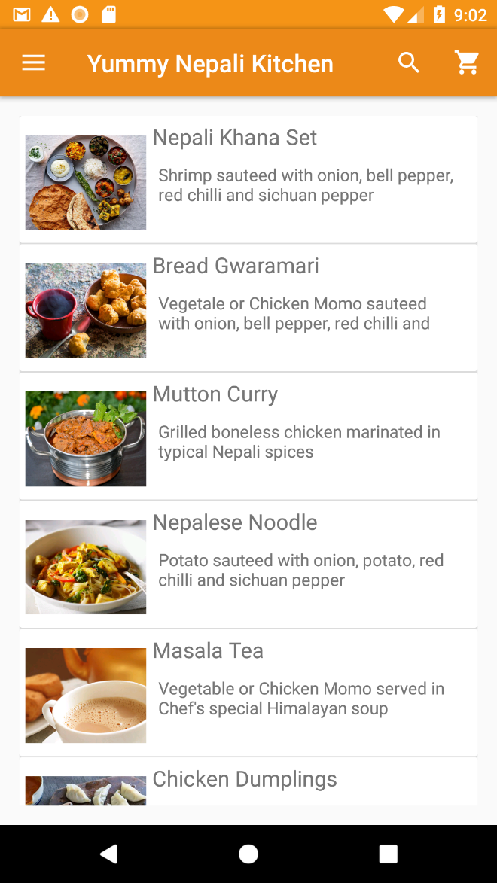
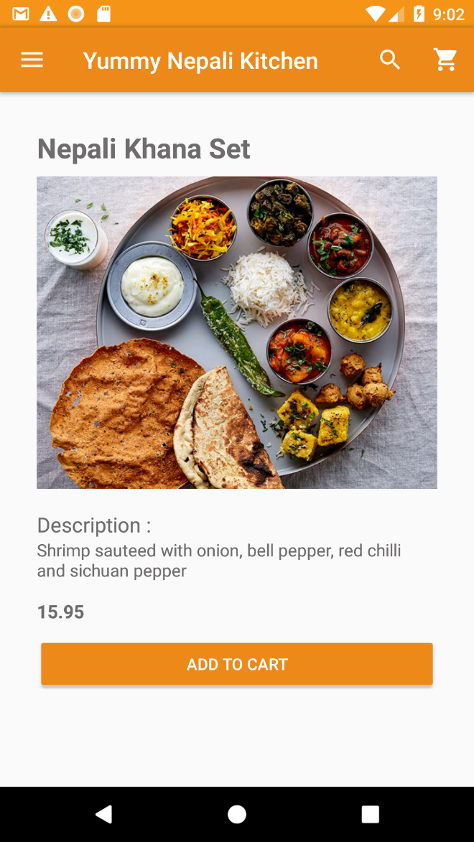
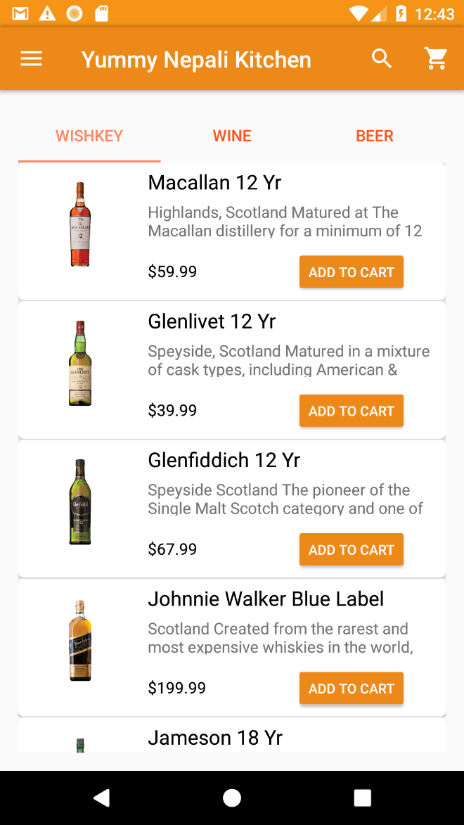
Copyright © 2017 All right reserved, Website : www.deepakgyawali.com.np

Slide 6
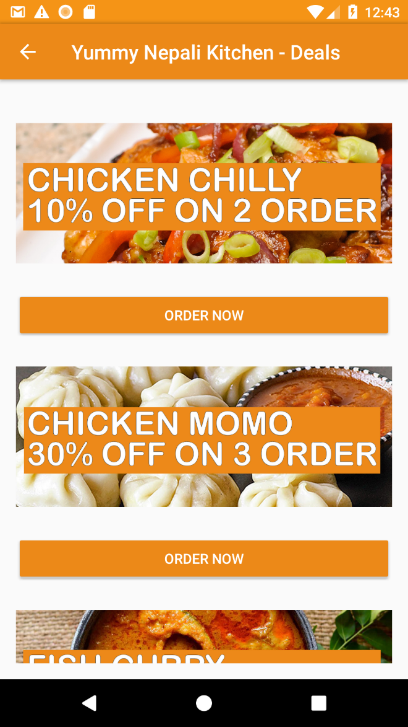
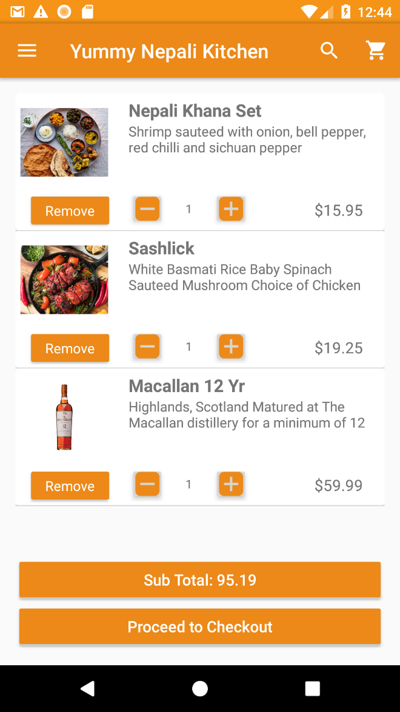
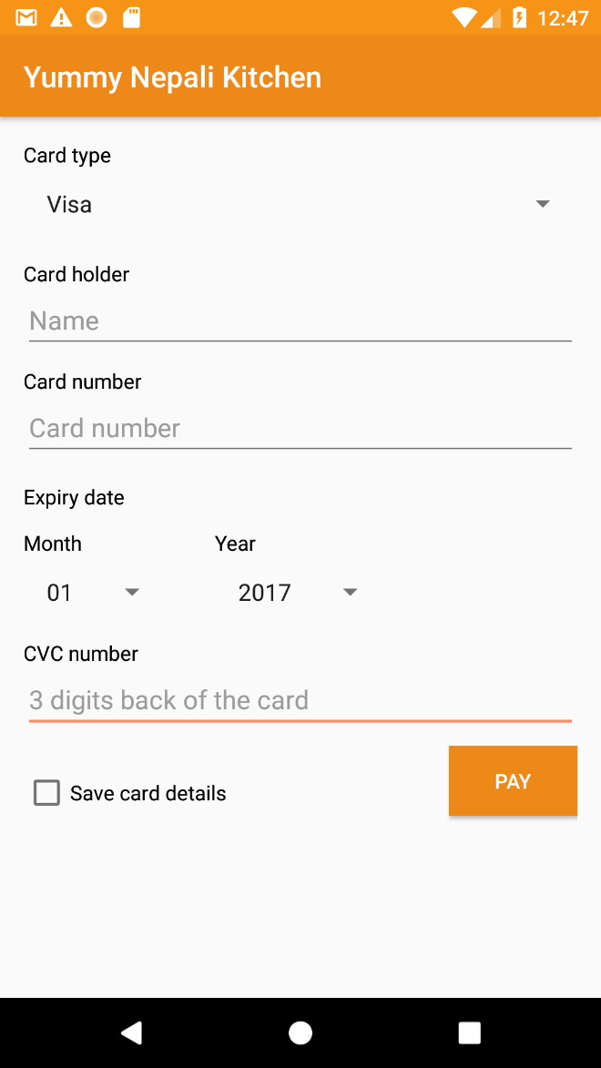
Copyright © 2017 All right reserved, Website : www.deepakgyawali.com.np

Slide 7
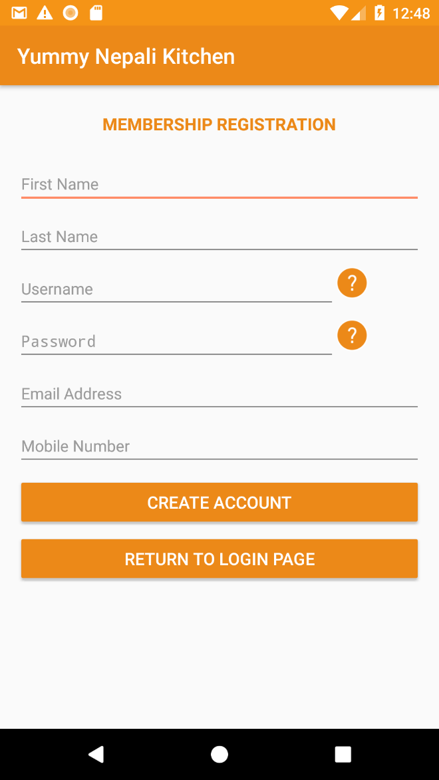




Tools Used
Tools & Language Used
Language Used
Android Studio
GenY motion
Virtual Box
FileZilla
JAVA
XML
SQL
PHP
Copyright © 2017 All right reserved, Website : www.deepakgyawali.com.np

Slide 8
Android Studio Concepts Used
onCreate: Used to start an activity.
Intent: Object that provides runtime binding between separate components, such as two activities.
Bundle: Bundles are generally used for passing data between various Android activities.
Shared Preferences: Android provides many ways of storing data of an application. One of this way is called Shared Preferences.
Fragments: A Fragment represents a behavior or a portion of user interface in an Activity. We can combine multiple fragments in a single activity to build a multi-pane UI and reuse a fragment in a single activity.
NavigationView: The navigation drawer is a panel that displays the app’s main navigation options on the left edge of the screen.
View: View objects are used specifically for drawing content onto the screen of an Android device. While we can instantiate a View in our Java code, the easiest way to use them is through an XML layout file.
Adapter/AdapterView/ArrayAdapter: The Adapter provides access to the data items. The Adapter is also responsible for making a View for each item in the data set. The AdapterView could be a ListView, GridView, Spinner, etc.
Copyright © 2017 All right reserved, Website : www.deepakgyawali.com.np

Slide 9
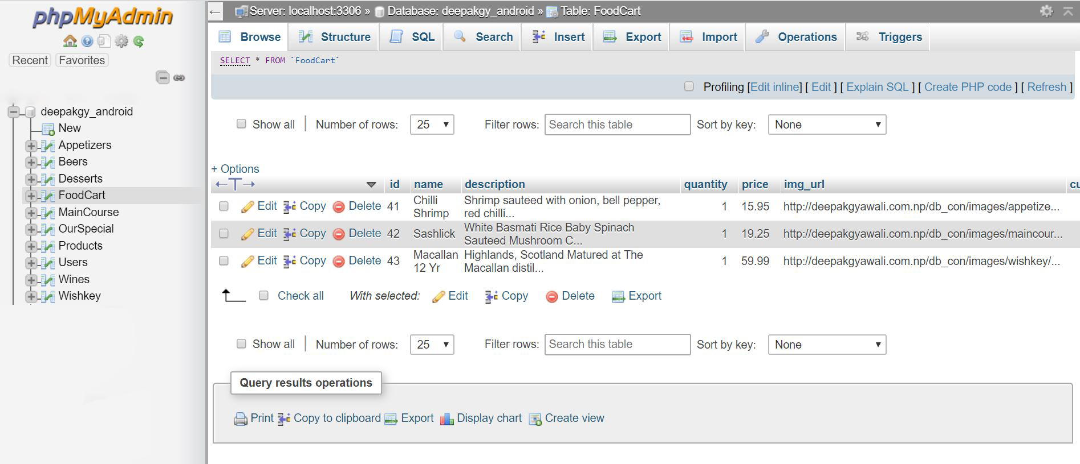
Database Structure
Copyright © 2017 All right reserved, Website : www.deepakgyawali.com.np

Slide 10
References
K. (2017, September 27). How to Connect Android with PHP MySQL - Generic AsyncTask. Retrieved December 11, 2017, from https://kosalgeek.com/connect-android-php-mysql-generic-asynctask/
SharedPreferences. (2017, October 25). Retrieved December 11, 2017, from https://developer.android.com/reference/android/content/SharedPreferences.html
Garcia - Rubia, D. (n.d.). Chapter 13. Accessing Files and Directories. Retrieved December 11, 2017, https://ecampus.viu.edu/pluginfile.php/317063/mod_resource/content/0/MADD_ch13_v01.pdf
Garcia - Rubia, D. (n.d.). Chapter 8. Exploring Building Blocks. Retrieved December 11, 2017, from https://ecampus.viu.edu/pluginfile.php/316526/mod_resource/content/0/MADD_ch9_v02.pdf
FrameLayout. (n.d.). Retrieved December 11, 2017, from https://developer.android.com/reference/android/widget/FrameLayout.html#attr_android:foregroundGravity
Copyright © 2017 All right reserved, Website : www.deepakgyawali.com.np

Slide 11
Live Demo
Copyright © 2017 All right reserved, Website : www.deepakgyawali.com.np

Slide 12
Thank You

